Slide 1
DATABASE MANAGEMENT SYSTEM
Vehicle Service Centre Management System
Submitted by
Course: B.Tech, AIML
Faculty: Dr. Kiran Mayee Adavala
Academic Year: 2026–2027
Reddy Keerthana – 25WU0101107
Morla Karthik – 25WU0102166
Shwechith Charan – 25WU0102261

Slide 2
Problem Description
Problem
Proposed Solution
Service centres handle large volumes of data on customers, vehicles, bookings, job cards, mechanics, spare parts, inspections and payments. Manual records can lead to:
A Vehicle Service Centre Management System built on a relational database stores and manages all service-related information in a structured, centralized manner.
Duplicate or inconsistent records
Difficulty tracking vehicle service history
Difficulty assigning mechanics and tasks
Errors in spare-part and billing records
Difficulty generating service reports
Main workflow
Customer → Vehicle → Service Booking → Job Card → Mechanic/Task → Spare Parts/Inspection → Invoice → Payment
DBMS | Vehicle Service Centre Management System 2

Slide 3
Objectives and Scope
Objectives
Scope
Maintain customer and vehicle details
Manage service bookings and job cards
Assign mechanics to service tasks
Track spare parts used during servicing
Record vehicle inspections
Generate invoices and maintain payment details
Maintain complete vehicle service history
Generate useful reports for the service centre
The system covers the complete service process: from vehicle registration and service booking, through job completion, billing and payment, to service-history tracking.
DBMS | Vehicle Service Centre Management System 3

Slide 4
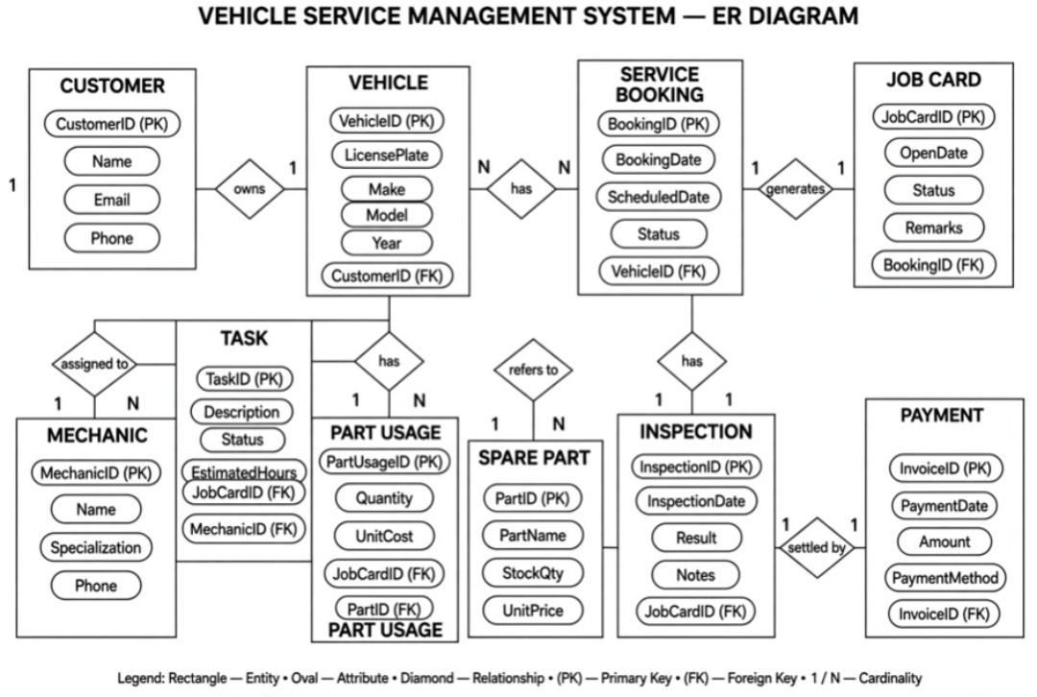
Entity Relationship Diagram
Key Relationships
A customer owns one or more vehicles
A vehicle can have multiple service bookings
A booking generates a job card
A job card contains multiple tasks
Mechanics are assigned to tasks
Spare parts are used for a job
A job can have inspection records
Completed jobs lead to invoices and payments
DBMS | Vehicle Service Centre Management System 4

Slide 5
Relational Schema and Normalization
Customer
Vehicle
Service_Booking
Job_Card
Customer_ID (PK), Name, Email, Phone
Vehicle_ID (PK), Customer_ID (FK), License_Plate, Make, Model, Year
Booking_ID (PK), Vehicle_ID (FK), Booking_Date, Scheduled_Date, Status
JobCard_ID (PK), Booking_ID (FK), Open_Date, Status, Remarks
Mechanic
Task
Spare_Part
Part_Usage
Mechanic_ID (PK), Name, Specialization
Task_ID (PK), JobCard_ID (FK), Description, Status, Estimated_Hours
Part_ID (PK), Part_Name, Stock_Quantity, Unit_Price
PartUsage_ID (PK), JobCard_ID (FK), Part_ID (FK), Quantity
Inspection
Invoice
Payment
Normalization
1NF: atomic values, no repeating groups
2NF: full dependency on the primary key
3NF: no non-key dependencies
Inspection_ID (PK), JobCard_ID (FK), Inspection_Date, Result, Notes
Invoice_ID (PK), JobCard_ID (FK), Total_Amount
Payment_ID (PK), Invoice_ID (FK), Payment_Date, Amount, Payment_Method
Result: reduced data redundancy and no insertion, update or deletion anomalies.
DBMS | Vehicle Service Centre Management System 5

Slide 6
Database Creation and SQL
Table design uses
Insert Data
Primary Keys
Foreign Keys
NOT NULL
INSERT INTO Customer
VALUES (1, 'Rahul Kumar',
'rahul@gmail.com', '9876543210');
UNIQUE
CHECK
DEFAULT values
Update Data
Create Table
UPDATE Customer
SET Phone = '9876501234'
WHERE Customer_ID = 1;
CREATE TABLE Customer (
Customer_ID INT PRIMARY KEY,
Name VARCHAR(100) NOT NULL,
Email VARCHAR(100),
Phone VARCHAR(15)
);
Delete Data
DELETE FROM Customer
WHERE Customer_ID = 1;
DBMS | Vehicle Service Centre Management System 6

Slide 7
Queries and Reports
1. Display Pending Jobs
2. Vehicle Service History
3. Mechanic Workload
SELECT *
FROM Job_Card
WHERE Status = 'Pending';
SELECT v.License_Plate,
j.JobCard_ID, j.Status
FROM Vehicle v
JOIN Service_Booking b
ON v.Vehicle_ID = b.Vehicle_ID
JOIN Job_Card j
ON b.Booking_ID = j.Booking_ID;
SELECT m.Name,
COUNT(t.Task_ID) AS Total_Tasks
FROM Mechanic m
JOIN Task t
ON m.Mechanic_ID = t.Mechanic_ID
GROUP BY m.Name;
Reports Generated
Pending jobs
Vehicle service history
Mechanic workload
Spare-part usage
Turnaround time
Revenue
DBMS | Vehicle Service Centre Management System 7

Slide 8
Proposed User Interface & System Workflow
A simple interface lets service-centre staff manage the complete service process.
1. Customer Registration
2. Vehicle Registration
3. Service Booking
4. Job Card Management
Enter name, phone, email; store in database
Enter plate, make, model, year; link to customer
Select vehicle; enter booking and scheduled dates
Create job card, add tasks and remarks, update status
5. Mechanic Assignment
6. Spare Parts
7. Billing and Payment
8. Service History
Assign mechanic to tasks; track task status
Select parts, record quantity, update stock
Generate invoice; record payment details
Search a vehicle; show previous service records
Customer → Vehicle → Booking → Job Card → Mechanic → Parts/Inspection → Invoice → Payment → History
DBMS | Vehicle Service Centre Management System 8
Notes:
Our proposed user interface is designed to connect the front end with the database. It will allow service-centre staff to perform CRUD operations, search records and generate reports. The UI will be implemented using Java or Python and connected to the relational database.

Slide 9
Testing and Expected Results
Test Case | Expected Result
Add Customer | Customer record stored successfully
Register Vehicle | Vehicle linked to the correct customer
Create Booking | Booking stored with valid vehicle details
Create Job Card | Job card generated for the booking
Assign Mechanic | Task linked to the selected mechanic
Add Spare Part | Part usage recorded correctly
Generate Invoice | Invoice amount calculated and stored
Record Payment | Payment linked to the invoice
Search Service History | Previous service records displayed
Invalid Data | Appropriate validation/error message shown
Expected Outcome
Accurate records
Reduced duplicate data
Relationships kept via foreign keys
CRUD operations supported
Useful reports generated
Faster access to vehicle service history
DBMS | Vehicle Service Centre Management System 9
Notes:
Since our project implementation is still in progress, these are the test cases and expected results that will be verified after connecting the application with the database.

Slide 10
Conclusion and Future Enhancements
Conclusion
Future Enhancements
The system provides a structured relational database for managing customers, vehicles, bookings, job cards, mechanics, tasks, spare parts, inspections, invoices and payments.
It aims to reduce manual work, minimize data redundancy, maintain accurate service records and make service-centre information easier to retrieve and manage.
Online service appointment booking
SMS/email service reminders
Customer login portal
Online payment integration
Spare-part low-stock alerts
Mechanic performance analytics
Mobile application
Cloud-based database access
AI-based maintenance prediction
Thank You
DBMS | Vehicle Service Centre Management System 10

